Slide 1


Nonparametric permutation techniques
Jörn M. Horschig
Donders Institute for Brain, Cognition and Behaviour

Slide 2
Talk outline
Inferential statistics
Channel-level statistics
  parametric
  non-parametric
Source-level statistics
  non-parametric

Slide 3
Inferential parametric statistics
You make N observation and want to find whether some hypothesis H0 is true.
Step 1: Gathering data
Observation
Value
0
2.5
1
-3.2
count
.
.
.
N
2.4
value

Slide 4
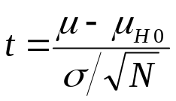
Inferential parametric statistics
You make N observation and want to find whether some hypothesis H0 is true
Step 2: Statistical testing
Determine probability of t under H0
If t sufficiently unlikely, reject H0
μ
μ_{H0}
Observation
Value
0
2.5
1
-3.2
count
.
.
.
σ
N
2.4
value

Slide 5
Inferential parametric statistics
Observations
in condition 1
Observations
in condition 2
x1, x2, x3, x4, …
y1, y2, y3, y4, …
t-statistic
distribution of x
distribution of y
The same principle applies
Notes:
say we have observed variable x multiple times in one condition, and multiple times in another
for each of the conditions the variable x will have a distribution
one of the parameters of that distribution is hypothesized to be different, usually the mean
the difference is quantified, for example with a t-statistic
we know … hence we can asses the likelyhood of the observed difference in the two conditions

Slide 6
Parametric statistical testing
You make N observation and want to find whether some hypothesis H0 is true.
Pitfall:
You require a known distribution.
μ
Observation
Value
0
2.5
1
-3.2
count
.
.
.
σ
σ
N
2.4
value

Slide 7
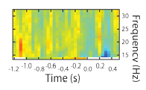
Multiple comparison problem
16 *30 time-frequency tiles, i.e. 480 comparisons.
t-test with α = 0.05 (chance of false alarm rate)
Chance of one false alarm in 480 tests: 99.99…%
  Or: 480*0.05 = 24 false alarms
for one test

Slide 8
Multiple comparison problem
Whole-brain analysis
306 channels
100 timepoints
50 frequencies
  1.530.000 statistical tests
5% chance of false alarm in every test
  76.500 false alarms

Slide 9
Multiple comparison problem
Solutions to control the FWER
  Bonferroni correction
  Use the false discovery rate
  Use Monte-Carlo approximation of the randomization distribution of the “maximum statistic”
cfg = [];
cfg.method = ‘analytic’
cfg.correctm = ‘bonferroni’
ERPstats = ft_timelockstatistics(cfg, ERP);
cfg = [];
cfg.method = ‘analytic’
cfg.correctm = ‘fdr’
ERPstats = ft_timelockstatistics(cfg, ERP);
cfg = [];
cfg.method = ‘montecarlo’
cfg.correctm = ‘max’
ERPstats = ft_timelockstatistics(cfg, ERP);
cfg = [];
cfg.method = ‘montecarlo’
cfg.correctm = ‘max’
TFRstats = ft_freqstatistics(cfg, TFR);

Slide 10
Randomization test: general principle
  Independent variable: condition
  Dependent variable: data
H0: the data is independent from the condition in which it was observed
The data in the two conditions is not different

Slide 11
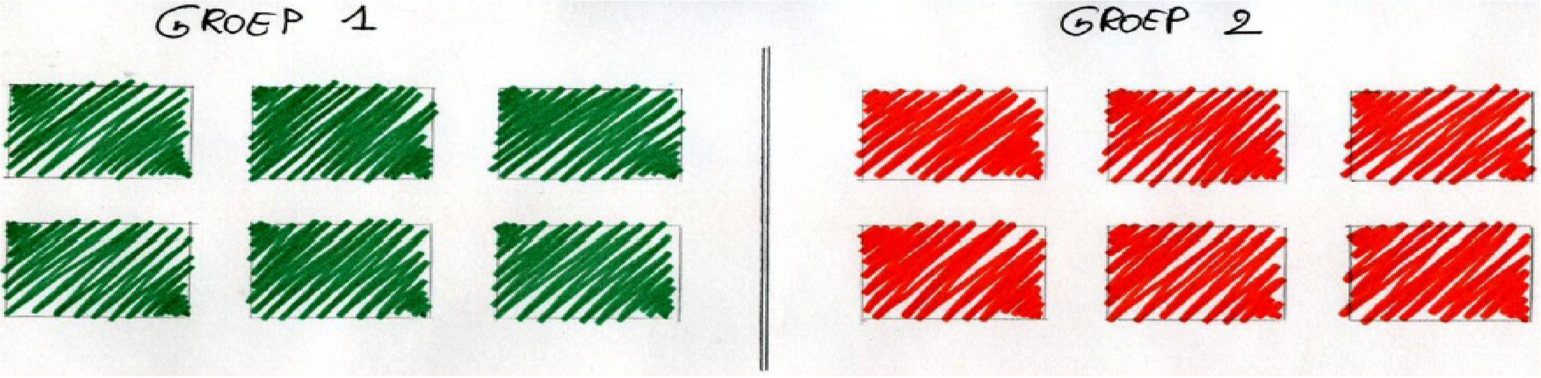
Randomization approach
Notes:
Pool them together, and select randomly a new set for group 1 and group 2
Randomization refers to randomly reasigning the data over the two conditions
or - if you want - randomly reassigning the condition label to the data
Under H0 that is valid

Slide 12
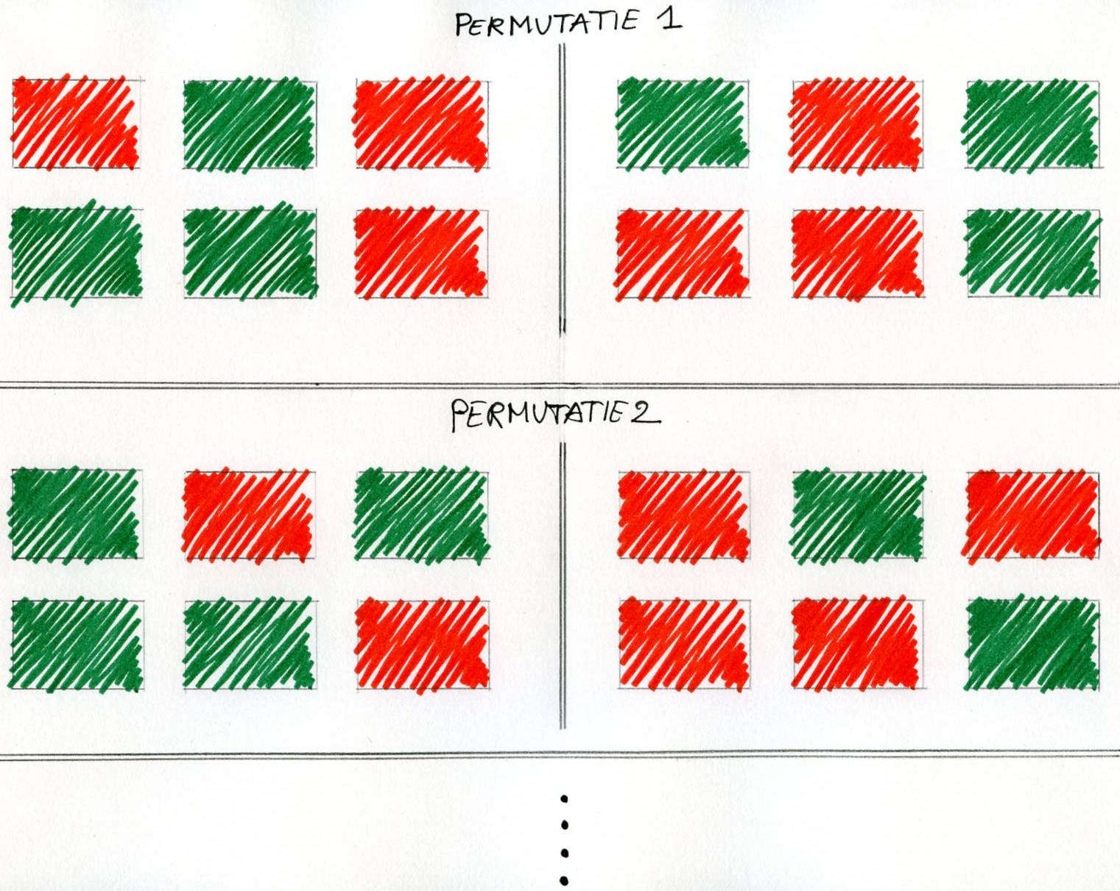
Randomization approach

Slide 13
Randomization approach
e.g. compute mean
and variance
a
a
a
a
analyze
a
a
e.g. compute t-score
difference
X_{org}
b
b
b
analyze
b
b
b

Slide 14
Randomization approach
a
a
b
a
analyze
b
b
difference
X₁
a
a
b
analyze
b
b
a

Slide 15
Randomization approach
b
b
a
a
analyze
b
a
difference
X₂
a
b
a
analyze
b
a
b

Slide 16

Randomization approach
b
b
a
a
b
a
X₂
a
b
a
b
a
b

Slide 17
Distribution of “x” can take any shape
X_{org}
2.5%
97.5%
2.5%
97.5%
2.5%
97.5%

Slide 18
Non-parametric statistics
Randomization of independent variable
Hypothesis is about data, not about the specific parameter
Randomization distribution of the statistic of interest “x” is approximated using Monte-Carlo approach
H0 is tested by comparing observed statistic v.s. randomization distribution
Notes:
So to summarise…

Slide 19
Avoid the multiple comparison problem
The statistic “x” can be anything
Rather than testing everything, only test the most extreme observation (i.e. the max statistic)
Compute the randomization distribution for the most extreme statistic
X_{org}
2.5%
97.5%
Notes:
So to summarise…

Slide 20
Statistics
Conventional is univariate parametric
Our approach is to consider the data
  Many channels, timepoints, frequencies
  Massive univariate
  Multiple comparison problem
  There is structure in data

Slide 21
Increasing the sensitivity
channel/time/frequency points are not independent
neighbouring channel/time/frequency points are expected to show similar behaviour
combine neighbouring samples into clusters -> “accumulate the evidence” = cluster-based statistics
‘Correct’ for MCP by computing the likelihood of a cluster having the observed size

Slide 22
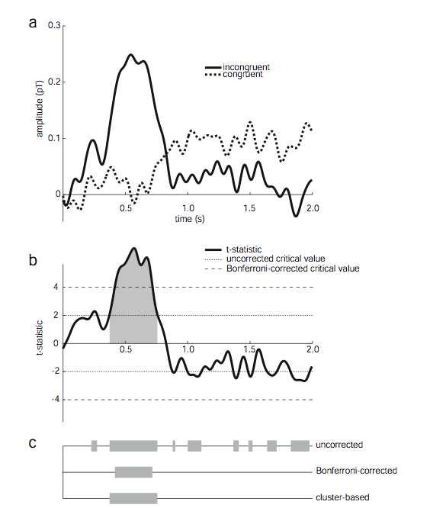
Clustering in time

Slide 23
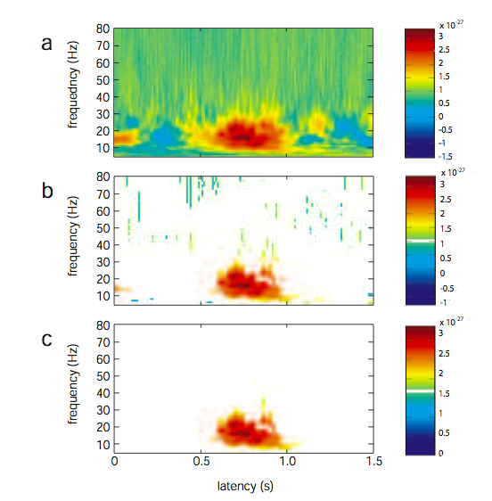
Clustering in time-frequency

Slide 24
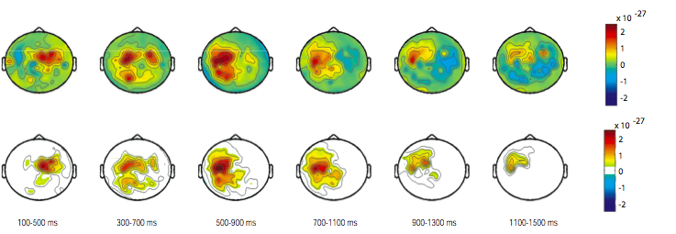
Clustering in time-frequency-space
channels

Slide 25
Toy example

Slide 26
Toy example: original observation
  null hypothesis: condition A = condition B
Condition A
  S1_a
  S2_a
  S3_a
  S4_a
  S5_a
  S6_a
  S7_a
  S8_a
  S9_a
  S10_a
Condition B
  S1_b
  S2_b
  S3_b
  S4_b
  S5_b
  S6_b
  S7_b
  S8_b
  S9_b
  S10_b

Slide 27
Toy example: 1st permutation
  null hypothesis: condition A = condition B
Condition A
  S1_a
  S2_b
  S3_a
  S4_a
  S5_b
  S6_b
  S7_a
  S8_a
  S9_a
  S10_b
Condition B
  S1_b
  S2_a
  S3_b
  S4_b
  S5_a
  S6_a
  S7_b
  S8_b
  S9_b
  S10_a

Slide 28
Toy example: 2nd permutation
  null hypothesis: condition A = condition B
Condition A
  S1_b
  S2_a
  S3_b
  S4_a
  S5_a
  S6_b
  S7_a
  S8_b
  S9_b
  S10_a
Condition B
  S1_a
  S2_b
  S3_a
  S4_b
  S5_b
  S6_a
  S7_b
  S8_a
  S9_a
  S10_b

Slide 29
Toy example: Original observation
Permute labels conditions and calculate test statistic
  null hypothesis: condition1 = condition2
statistic = 17
Observation 17

Slide 30
Toy example: 1st permutation
Permute labels conditions and calculate test statistic
  null hypothesis: condition1 = condition2
statistic = 13
Observation 17

Slide 31
Toy example: 1st permutation
Permute labels conditions and calculate test statistic
  null hypothesis: condition1 = condition2
statistic = 13
Observation 17
Permutation 1 13

Slide 32
Toy example: 2nd permutation
Permute labels conditions and calculate test statistic
  null hypothesis: condition1 = condition2
Observation 17
Permutation 1 13
Permutation 2 11
statistic = 11

Slide 33
Toy example: 3rd permutation
Permute labels conditions and calculate test statistic
  null hypothesis: condition1 = condition2
statistic = 12
Observation 17
Permutation 1 13
Permutation 2 11
Permutation 3 12

Slide 34
Toy example: N^{th} permutation
Permute labels conditions and calculate test statistic
  null hypothesis: condition1 = condition2
statistic = …
Observation 17
Permutation 1 13
Permutation 2 11
Permutation 3 12
...

Slide 35
Compute the likelihood of the observed max cluster size
X_{org}
2.5%
97.5%
2.5%
97.5%
2.5%
97.5%

Slide 36
Summary channel stats
Parametric statistical models for many channel-time-frequency points
  probability for H0
  one H0 for each channel-time-frequency
  multiple comparison problem
Non-parametric approach for estimating probability
  randomization or permutation
  probability of H0 for arbitrary statistic
  incorporate prior knowledge in statistic
  avoid MCP using prior knowledge

Slide 37
Source-level statistics
Same principles as channel-level statistics
Beamforming
  Swap data between conditions: use common filters

Slide 38
Inferential parametric statistics
Observations
in condition 1
Observations
in condition 2
x1, x2, x3, x4, …
y1, y2, y3, y4, …
t-statistic
distribution of x
distribution of y
The same principle applies
Notes:
say we have observed variable x multiple times in one condition, and multiple times in another
for each of the conditions the variable x will have a distribution
one of the parameters of that distribution is hypothesized to be different, usually the mean
the difference is quantified, for example with a t-statistic
we know … hence we can asses the likelyhood of the observed difference in the two conditions

Slide 39
Inferential statistics: multivariate data
[
x1, x2, x3, x4, …
x1, x2, x3, x4, …
]
dim = [x, y, z]
dim = [x*y*z, 1]
Notes:
the type of data that we are confronted with is volumetric, i.e. we have an estimate of activity at every location in the brain. The source activity can thus be seen as a volume with dimensions
It is also possible to represent the same data vectorized, which is what I will do now for convenience

Slide 40
Inferential statistics: parametric multivariate
[
x1, x2, x3, x4, …
x1, x2, x3, x4, …
]
t-statistic
Notes:
since we have observed the data in many trials in both conditions, that means that we have many volumes. For any fixed voxel in those volumes we can compute a t-statistic.
and of course we can compute the statistic for all voxels, resulting in a t-volume
what we normally would do is a parametric test for every voxel -> however MCP, furthermore all the independent tests do not make use of the known spatially blurred source activity estimate

Slide 41
Randomization test: general principle
“s” statistic
Notes:
Inferfential statistics based on a randomization test states that the data independent is from the condition in which it was observer, or that the distribution of the data does not depend on the condition. This means that the data can be EXCHANGED or PERMUTED. For each permutation we will obtain another realization of the statistic of interest that is equally likely under H0

Slide 42
Distribution of “s” can take any shape
S_{org}
2.5%
97.5%
2.5%
97.5%
2.5%
97.5%
Notes:
The distribution of the statistic that we compute can take any shape,
for example more or less normal, or skewed, or anything
the only thing that is relevant is to determine how likely the statistic with the data as it was observed in both conditions was, given the randomization distribution of the statistic that we just determined
note that the randomization distribution is usually estimated using a monte-carlo approach
… It is possible to do this randomization test on a multivatiate statistic. However, multivariate tails of the multivariate distribution are difficult to determine, and it is difficult to control the false-alarm rate with sufficient sensitivity, therefore we revert to a univariate statistic

Slide 43
Randomization test: cluster statistic
a-priori threshold
cluster neighbouring voxels
compute sum over cluster
2.5%
97.5%
Notes:
this univariate statistic is a cluster statistic
remember that the multivariate statistic for all voxels can be expressed as volume.
if we take an a-priori threshold, we can determine which voxels exceed the threshold. Subsequently in the resulting binary volume we can determine neighbouring voxels that together form clusters.
The statistic that we subsequently remember for our randomization distribution is the sum of the single-voxel statistic over the significant cluster. Actually, we only use this value of the largest cluster which automatically corrects for the multiple comparision problem.

Slide 44
Returning to beamforming
one trial
t-map
one condition
H0: same distribution
Notes:
sofar it was generally applicable to volumetric data, so let us now return to beamforming

Slide 45
Common filters for beamforming
X(t) = h s(t) + N
ŝ(t) = w^{T} X(t)
w^{T} = ( h^{T} Cov⁻¹ h)⁻¹ h^{T} Cov⁻¹
P = ŝ ŝ ^{T}
= w^{T}Cov w
Cov = X X^{T}
Cov _{i} = X_{i} X_{i}^{T} for trial i=1, 2, 3, …
Legend:
h: leadfield matrix
s(t): real source activity
N: environmental noise
X(t): sensor-level data
ŝ(t): estimate source activity
w^{T:}: inverse filter
Cov: Covariance/Cross-spectral density
P: Power of estimated sources
Cov = (Cov ₁ + Cov ₂ + Cov ₃ + … )
n
P_{i} = w^{T} Cov_{i} w
We can use the same common filter for each trial!
Notes:
in general for EEG or MEG we use the data model …
in the spatial filtering approach we estimate the activity of a single source using …
under the constraints of unit gain and minimum variance, the filter can be computed as…
given this filter, or given the source activity time series, we can coumpute the source power
in all of these equations the data covariance is indicated as R
let’s now turn to our experimental manipulation, which varies over trials. For every trial we have a separate data covariance.
The average data covariance can be computed from those, but the single trial data covariance can directly be used to estimate single trial power
The point that I want to stress here is that we can use a common filter for all trials…

Slide 46
Common filters for beamforming
one trial
t-map
one condition
H0: same distribution
Notes:
So if we look at how the data is experimentally built up, then we have separate trials… that were observed in two conditions.
Under H0 those trials all come from the same distribution, which means that it makes perfect sense to use one filter that is common to all trials in both conditions.
The filter can then be reapplied to each individual trial.

Slide 47
Summary source stats
average covariance over all data for spatial filter estimate
one spatial filter per voxel
  common to both conditions
  single-trial estimates: simple multiplication
Randomization test not affected
  exchangeability of data over conditions
  does not change filter
  computationally fast
Notes:
the recipe is to call sourceanalysis twice
first on all data with keepfilters=yes
second on each dataset with keeptrials=yes
subsequently you can call sourcestatistics where the randomization over trials will be done

Slide 48
Summary statistics
A formal hypothesis can be tested
  control the chance of false positives
  reduce the false negative rate
Multiple comparison problem
  one hypothesis per channel-time-frequency
  one hypothesis for all data
Increase sensitivity
  cluster-based analysis
  multivariate analysis

Slide 49
Further reading
Wiki > Tutorials > Statistics
Parametric and non-parametric statistics on event related fields
Cluster-based permutation tests on event related fields
Cluster-based permutation tests on time-frequency data
Multivariate analysis of MEG/EEG data

